Slide 1
Async And Await Programming Asynchronously The Cool Way
Brought To You By Your Asynchronous Neighborhood Polaris Developer

Slide 2
Code is here
https://github.com/TomAwesome/MultithreadFun

Slide 3
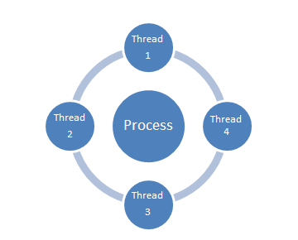
Who has Experience in Asynchronous Programming?

Slide 4
Object Lesson
Can I get a volunteer to help out?

Slide 5
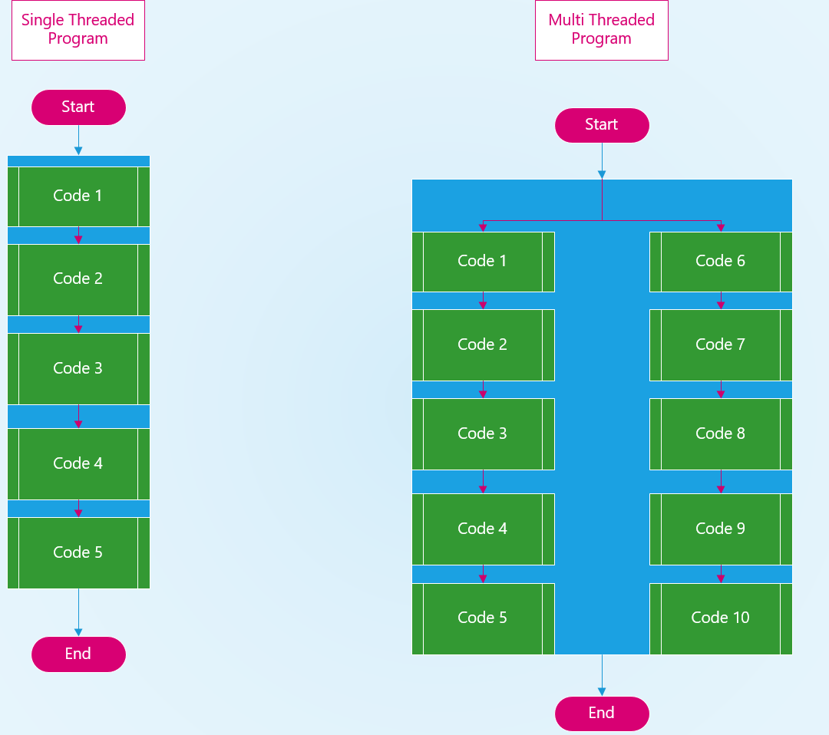

Slide 6
Questions on the Concept of Multi-Threaded Programs?

Slide 7
Lets Dive into Multithreading in C#
The Old Threading model is C# uses a class called Thread.
https://msdn.microsoft.com/en-us/library/system.threading.thread(v=vs.110).aspx
We won’t be covering how to use Thread
What we are interested in is the Task class
https://docs.microsoft.com/en-us/dotnet/standard/parallel-programming/task-based-asynchronous-programming

Slide 8
What Is a Task?
A unit of work that is ran asynchronously.
It still runs in the .Net ThreadPool
.Net ThreadPool will queue the task to be executed.

Slide 9
Why Task over Thread?
More efficient and more scalable use of system resources.
Behind the scenes, tasks are queued to the ThreadPool, which has been enhanced with algorithms that determine and adjust to the number of threads and that provide load balancing to maximize throughput. This makes tasks relatively lightweight, and you can create many of them to enable fine-grained parallelism.
More programmatic control than is possible with a thread or work item.
Tasks and the framework built around them provide a rich set of APIs that support waiting, cancellation, continuations, robust exception handling, detailed status, custom scheduling, and more.
Information came from https://docs.microsoft.com/en-us/dotnet/standard/parallel-programming/task-based-asynchronous-programming

Slide 10
How to use Task
Task taskA = new Task( () => Console.WriteLine("Hello from taskA."));
taskA.Start();
taskA.Wait();

Slide 11
Another Way
Task taskA = Task.Run( () => Console.WriteLine("Hello from taskA."));
taskA.Wait();
Task.Run() is the preferred way of creating and starting a Task.
It will create and start the Task.

Slide 12
Lets look at a code example

Slide 13
What’s Up With Task Order?
When a Task gets created and started it is put into the ThreadPool
The ThreadPool handles all things Threads
Queues the thread to run.
Provides a pool of worker threads that are managed by the system.
Wait Handles and when to execute the callback function.
How many Threads can I have?
There is not an inherent limit
It depends on the physical resources that are available to the process
There are default values for it.

Slide 14
Lets Check What My Max Threads Are

Slide 15
Lets Go Over Flow of Control
https://docs.microsoft.com/en-us/dotnet/csharp/programming-guide/concepts/async/

Slide 16
Now That We Know About Tasks
How do we get data from a Task?
It has never been easier.
Task is a generic class and can return a type of your choice.
Task<T> in the signature of the method.

Slide 17
So What’s This Async And Await
They are Keywords in C#
Async means that this method will return a Task.
Await means wait for this task to finish and then return here.
Think about it kind of like a call back. Once it is done call this code.
It suspends the execute of the method until the asynchronous operation finishes.
The Compiler will do a much of magic behind the scenes to the method. It will create callbacks for the awaits.
You Can’t use Await without Async

Slide 18
Async And Await Continued
Async and Await are an implementation detail.
A interface just needs to declare the method returns a Task<T>
The Concrete implementation of the interface can choose to use Async and Await
Let look a Code Example.

Slide 19
Tasks Are Always Awaitable
If a method returns a Task but is not marked Async you can still await it.

Slide 20
Naming Convention
The Naming Convention for Asynchronous methods are to end the method name in Async
Example “MakeRequestAsync”

Slide 21
Await Will Bubble Up Exceptions
If you await a method and it throws an exception. This exception will bubble up to the method that awaited it.
This makes exception handling much easier. It will also have useful stacktrace
If you don’t await it you will have to check if the exception faulted and get that exception and throw it.
.Result() or .Wait() will also throw an exception. “Aggregate Exception”
It can be flattened into a single exception.

Slide 22
Return From Await
When you return from an Await.
It Queues work on the thread that called it.
This means if a GUI thread called something asynchronously it will be queued on that thread to resume the work after the return.

Slide 23
Locking
You can use “Lock” to allow only one thread at a time to access the code in the “Lock” block
You can use objects and string as the object to lock on.
Using a string as a lock means it locks the string value and not the object reference to the string.
Avoid locking on public type, or instances beyond your code control
Don’t do lock(this), lock(typeof(mytype)) or lock(“mylock”)
You Can’t use an Await in a Lock block.

Slide 24
Dead Lock
Dead lock can occur if you have code that is trying to get more than one lock.
How to help prevent Dead Lock.
Avoid locking on public type, or instances beyond your code control
Use only one lock if possible.
Keep code in the lock block as minimal as possible.
Create a private object in the class to lock on
private object lock1 = new object();
If you are needing to acquire more than one lock it’s probably a code smell and needs to be redesigned.

Slide 25
Collections
Whenever you are working with collections that can be accessed by multiple threads. The collection needs locks around its access.
Linq is helpful to create copies of your collection so you don’t need to hold a lock for a long period time while you foreach over the collection.

Slide 26
Concurrent Collections
There are collections built into .Net that handle the locking for you.
https://docs.microsoft.com/en-us/dotnet/standard/collections/thread-safe/
These are useful so you don’t have to write all the locking code.

Slide 27
Unit Testing
Nunit allows for tests to be async
The Return type needs to be a “Task” not void
[Test]
public async Task TestExample() { }

Slide 28
Lets Fix a Blocking Program
I have created a program that has a blocking UI. Lets fix it so it doesn’t block anymore.
Take some time to fix and I’ll help out with any questions you have.

Slide 29
Parallel
There is a class that allows you to do a Parallel foreach and for.
It is a blocking call and will wait for all the Task to complete.
public static ParallelLoopResult ForEach<TSource>( IEnumerable<TSource> source, Action<TSource> body

Slide 30
Best Practices
Use Async and Await through the whole stack.
If you have a mixed model you can create blocking threads and possible get deadlocks.
Remember that Task are awaitable. It is good to return a Task.
Let the calling member worry about putting it in a Task.Run()
https://msdn.microsoft.com/en-us/magazine/jj991977.aspx

